Slide 1

-By Khushi Budhiraja
HEART DISEASE DIAGNOSTIC - ANALYSIS

Slide 2
Objective
Problem Statement
The goal of this project is to analyze the heart disease occurrence, based on a combination of features that describes the heart disease
Health is real wealth in the pandemic time we all realized the brute effects of covid-19 on all irrespective of any status. You are required to analyze this health and medical data for better future preparation.

Slide 3
Details of Data
age: The person's age in years
sex: The person's sex (1 = male, 0 = female)
cp: The chest pain experienced (Value 1: typical angina, Value 2: atypical angina, Value 3: non-anginal pain, Value 4: asymptomatic)
trestbps: The person's resting blood pressure (mm Hg on admission to the hospital)
chol: The person's cholesterol measurement in mg/dl
fbs: The person's fasting blood sugar (> 120 mg/dl, 1 = true; 0 = false)
restecg: Resting electrocardiographic measurement (0 = normal, 1 = having ST-T wave abnormality, 2 = showing probable or definite left ventricular hypertrophy by Estes' criteria)
thalach: The person's maximum heart rate achieved
exang: Exercise induced angina (1 = yes; 0 =no)
oldpeak: ST depression induced by exercise
relative to rest.
slope: the slope of the peak exercise ST
segment (Value 1: upsloping, Value 2: flat, Value 3: down sloping)
ca: The number of major vessels (0-3)
thal: A blood disorder called thalassemia (3 = normal; 6 = fixed defect; 7 = reversable defect)
num: Heart disease (0 = no, 1 = yes)

Slide 4
The Process
Data Collection
Data Cleaning
Data Visualization
Insights
Summary
By khushi budhiraja

Slide 5
Data Collection
The Data has been collected in the form of a CSV file named “heart disease diognostic.csv”.
The CSV file has data which contains 1025 rows and 14 columns.

Slide 6
Data cleaning and Transformation
Data Cleaning:
Ensured no missing values and outliers in the dataset.
Data Transformation:
Tool used: Python
Transformed some non-numeric data for clarity:
- Replaced '0' with 'Female' and '1' with 'Male' in the 'Sex' column.

Slide 7
Renamed columns for better readability:
-'age' to 'Age’
-‘sex' to 'Sex’
-'cp' to 'Chest Pain’
-'trestbps' to 'Resting Blood Pressure’
-'chol' to 'Cholesterol’
- fbs' to 'Fasting Blood Sugar'
- 'restecg' to 'Resting Electrocardiographic'
- 'thalach' to 'Max Heart Rate'
- 'exang' to 'Exercise Induced Angina'
- 'oldpeak' to 'Old Peak'
- 'slope' to 'Slope'
- 'ca' to 'Number of Major Vessels'
- 'thal' to 'Thal'
- 'target' to 'Target'

Slide 8
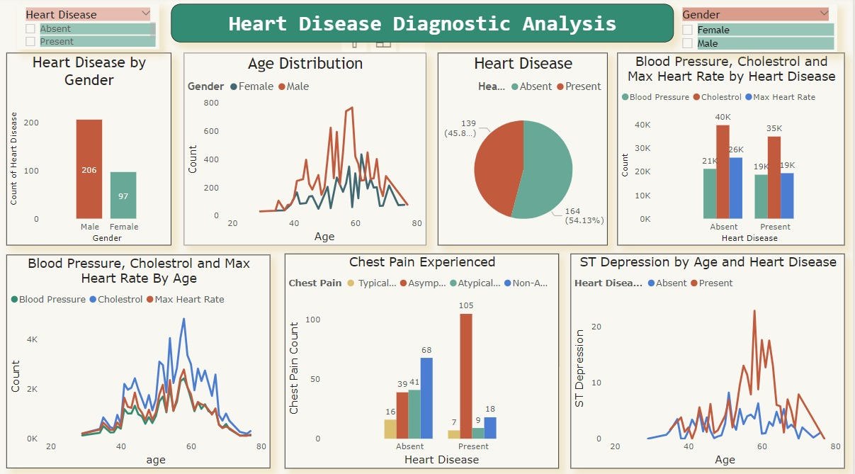
Data Visualization
(Through Power BI)

Slide 9
Insights
45.87% People suffering from heart disease.
Elderly Aged Men are more (50 to 60 Years) and Females are more in 55 to 65 Years Category
Males are more prone to heart disease.
Elderly Aged People are more prone to heart disease.
People having asymptomatic chest pain have a higher chance of heart disease.
High number of cholesterol level in people having heart disease.
Blood Pressure increases between age of 50 to 60 and somehow continue till 70.
Cholesterol and maximum heart rate Increasing in the age group of 50-60.
ST depression mostly increases between the age group of 30-40.

Slide 10
Summary
Elderly men aged between 50 to 60 years are most susceptible to heart disease, while women are more affected between ages 55 to 65.
A significant portion, 45.87%, of the population suffers from heart disease, with males being more prone than females.
Asymptomatic chest pain is strongly associated with a higher likelihood of heart disease.
High levels of cholesterol and blood pressure are prevalent among individuals diagnosed with heart disease, particularly increasing between ages 50 to 60 and continuing into the 70s.
ST depression, a crucial indicator, typically occurs in the age group of 30-40.
To effectively manage heart disease, focus on early detection and targeted interventions, especially for elderly men and women in their 50s and 60s. Regular monitoring of cholesterol and blood pressure levels is critical for timely intervention and prevention strategies.

Slide 11
Thank you

